Slide 1


VOTER MATCH Know where you stand
Carrie Andrews-Smith​
Pawarisa Sears​
Aysha Zayyad

Slide 2
Introduction
​Objective:
Build a Voter Match App that aligns users with political candidates based on their responses to policy-related questions.
Purpose:
Summarize policy stances for election candidates
Allow voters to choose stance closest to their own
Return ranked best-match candidates​
Tools:
Web scrapers
NLP
LLM
User Interface

Slide 3
Data, Models, and Libraries
​Data source:
https://ballotpedia.org
Web scraper:
Beautiful Soup
NLP & Language Models:
Natural Language Toolkit (nltk)
facebook/bart-large-cnn
roberta-large-mnli
Building our own LLM (Torch and Tiktoken)
User Interface:​
Gradio

Slide 4

Data Source and Web Scraping
Ballotpedia.org
Website containing a plethora of information on candidates running for office.
Has presidential election information starting with the 2016 election.​
For the scope of our project, we focused on candidate policy stances.​
Scraped candidate policy stances using Beautiful Soup.
Gathered presidential candidate data from 2016, 2020, & 2024; some US Senate candidate data from 2018, 2020, & 2022 for NC, and 2020 for AL.
Source::

Slide 5
Natural Language Processing
To ensure the input text is in a uniform and simplified format, making it easier
for models to process.
NLTK : ​
Tokenizer: TreebankWordTokenizer, which is suitable for English text.
Lemmatizer: WordNetLemmatizer, to convert words to their base forms.​
Using the roberta-large-mnli model for natural language inference (NLI),
Based on the RoBERTa (Robustly optimized BERT approach)
Variant of BERT (Bidirectional Encoder Representations from Transformers)

Slide 6
How it works
Data Extraction:
Sources: .docx files of candidates' policy positions.
Process: Extracts and organizes data by topic for each candidate.
Preprocessing:
Clean text: Lowercasing, tokenization, lemmatization.
Standardize phrases: specifically the replacement of multi-word phrases with
single tokens, "Black Lives Matter" → "black_lives_matter"
Matching:
Model: roberta-large-mnli (Natural Language Inference)
Compares user input with candidate policies
Scoring:
Aggregates alignment scores based on NLI results.

Slide 7

So...you want to build a User Interface?

Slide 8
🗳️ Voter Match App 🗳️
Using Gradio
User Input: User chooses response for each topic by selecting a single radio button
Presentation of Results
Topic-level results: Shows NLI label and confidence score for each topic for highest ranking candidate.
Overall alignment: Ranks candidates by their total average confidence scores.
Interactive Workflow
Users select their views on key topics.
The app processes the input, matches it with candidates, and ranks candidates based on alignment.

Slide 9
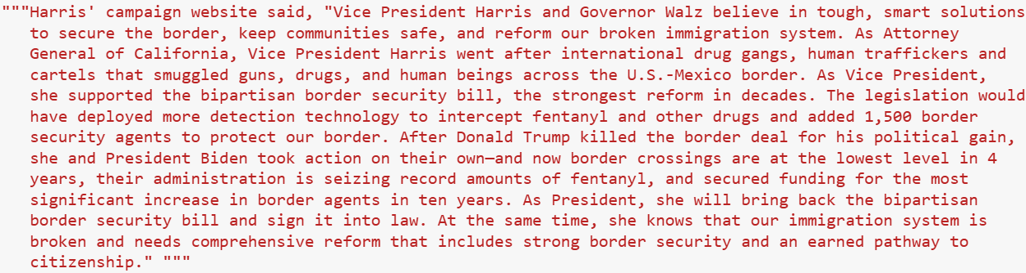





Sequence-to-Sequence Transformer
Purpose: Accepts input text and returns a summarization.
Example input:

Slide 10
Sequence-to-Sequence Transformer
Requested outputs:
Policy Sentences (as collected and cleaned by model)
Final Summary (as returned by model)
Summarization returned by facebook/bart-large-cnn:

Slide 11
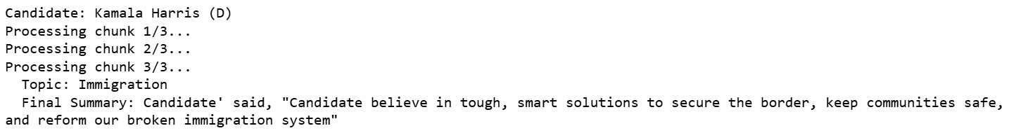
Sequence-to-Sequence Transformer
Requested outputs:
Policy Sentences (as collected and cleaned by model)
Final Summary (as returned by model)
Summarization returned by facebook/bart-large-cnn with chunking:

Slide 12
So...you want to build a Large Language Model?

Slide 13
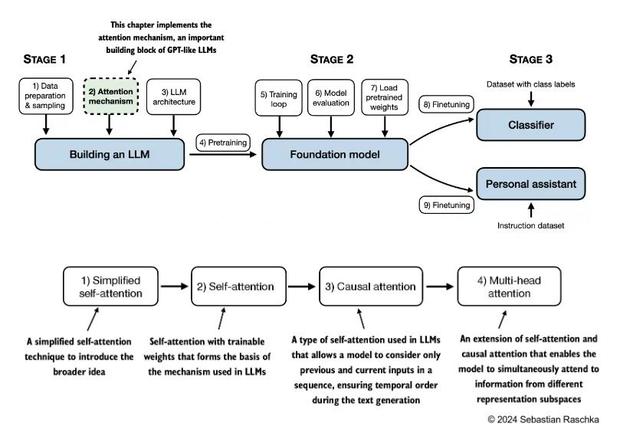
LLM Stages

Slide 14

LLM Data Preparation
Data preparation
Using the raw_text
(text file of web scraped data)
Creating a vocabulary
Tokenizing -> encoding/decoding
Simplified Self Attention
Compute Attention Scores
As dot products between inputs
Compute Attention Weights
Normalize Attention Scores
Compute Context Vectors
F
d
Using Sebastian Raschka's Github as the main source.

Slide 15
Future Work
Expand topics to cover more nuanced issues
Optimize code/app interaction
Continue work with seq-to-seq transformer models
Include state and local elections
Add multi-language support
Continue work on our own LLM with election specific text

Slide 16
Thank you!
Questions?

